Slide 1
Longboard Downhill / Freeride
Techniques Anatomy
By
DrSnowbird
2020-11-04

Slide 2
4.) Your body momentum direction
Rear foot
Front foot
Front foot
3.) Your board automatically start sliding
Rear foot
2.) Rear foot pushes out a bit - to help the initiation of the sliding.
Your
movement direction
1.) Pre-slide turning

Slide 3
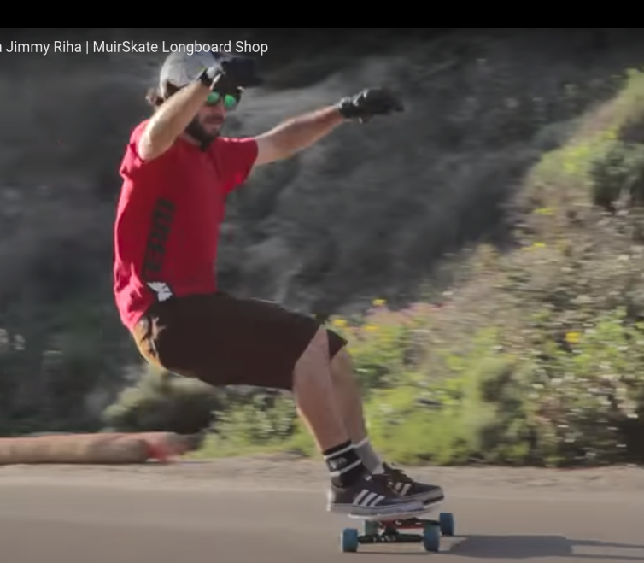
Eyes LOOKing at the direction of your movement to go.
Sitting on ‘virtual chair’ position to create PUSH sliding
Both feet ‘in-parallel’ with the ground!!

Slide 4
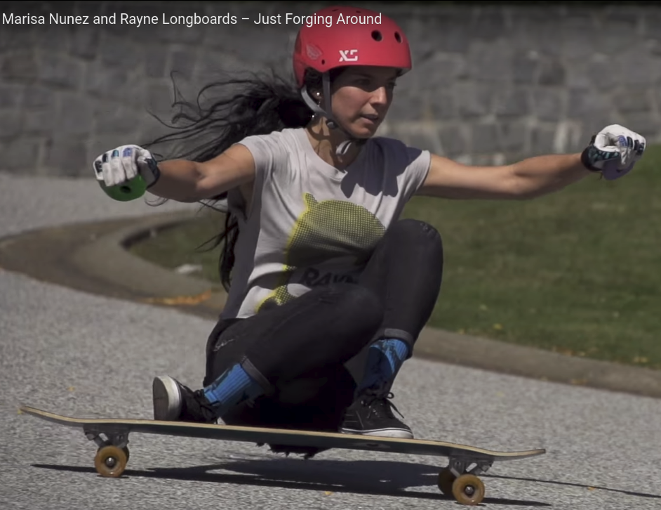
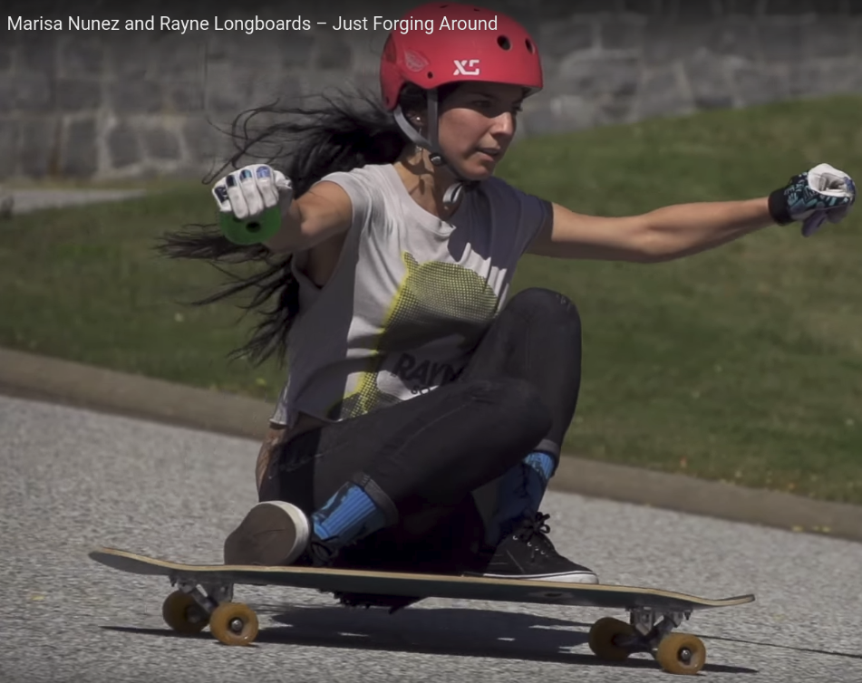
Sitting on ‘virtual ground (behind the board)’ position to create PUSH sliding

Slide 5
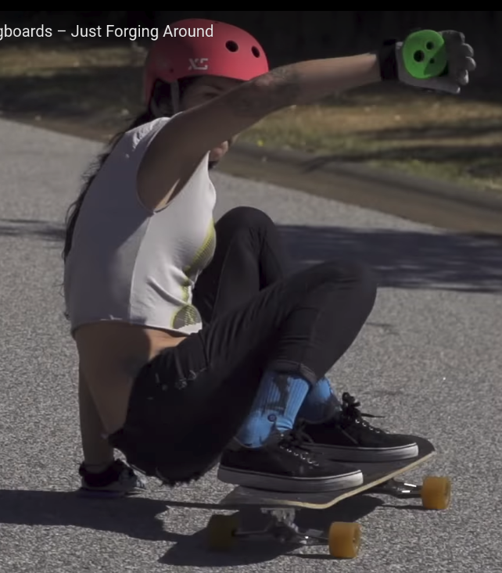
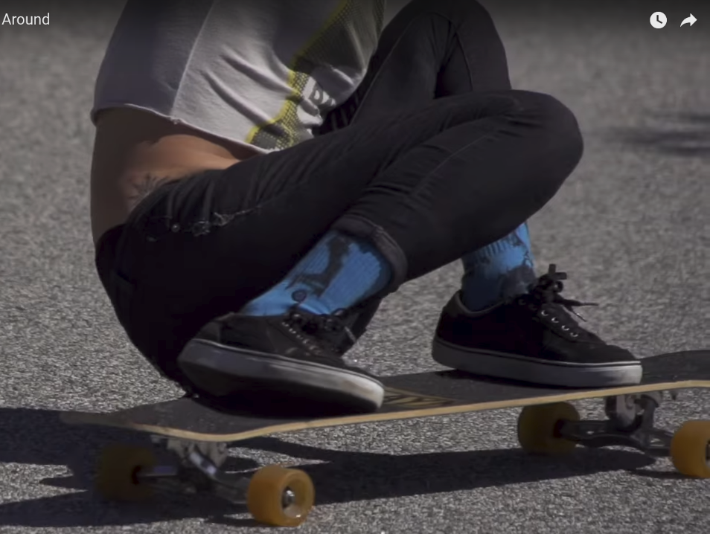
Coleman style back-end touching the ground in freeride (Note that Coleman style is not commonly seen in high-speed downhill-racing – see Racing Style in few pages down)

Slide 6
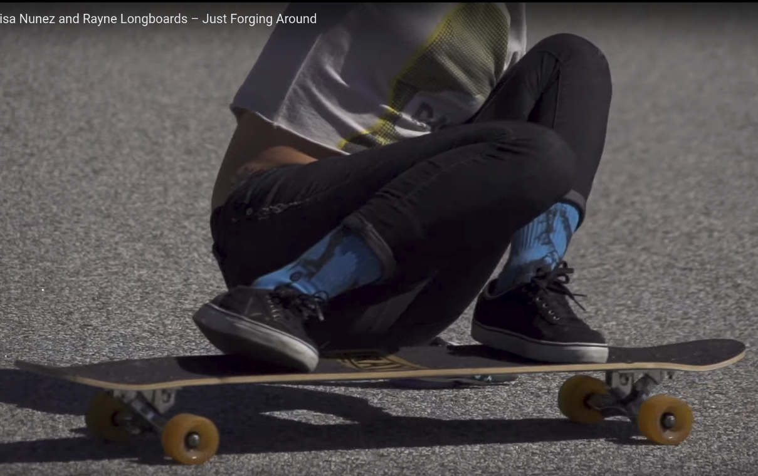
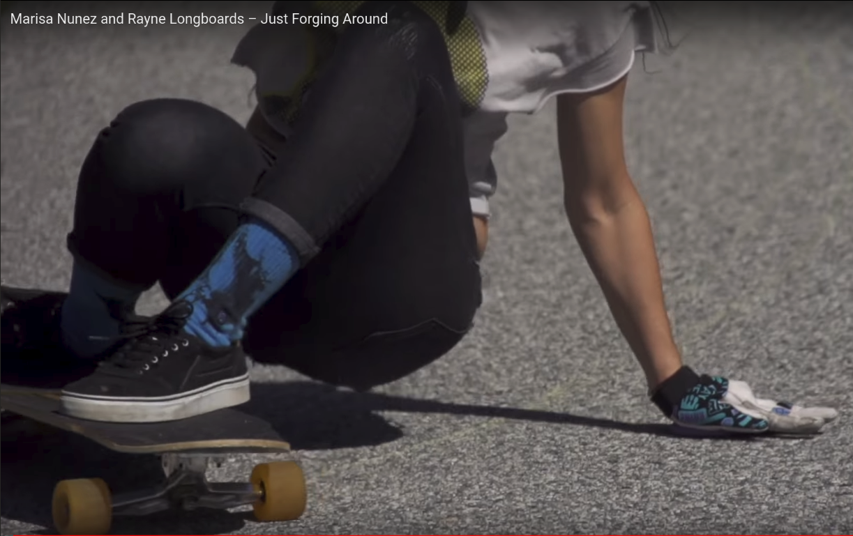

Slide 7
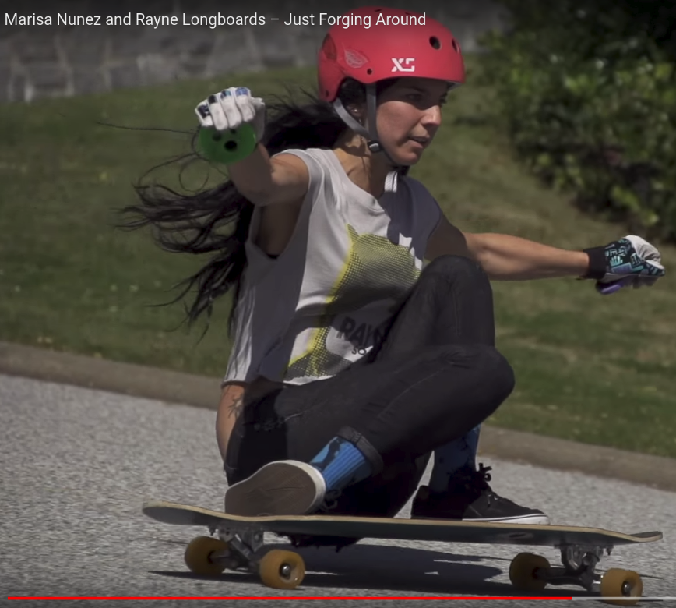
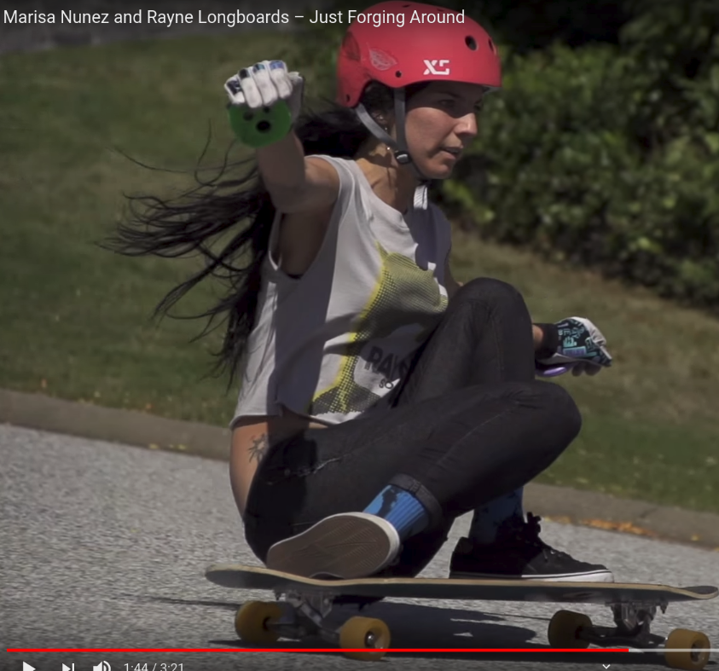

Slide 8
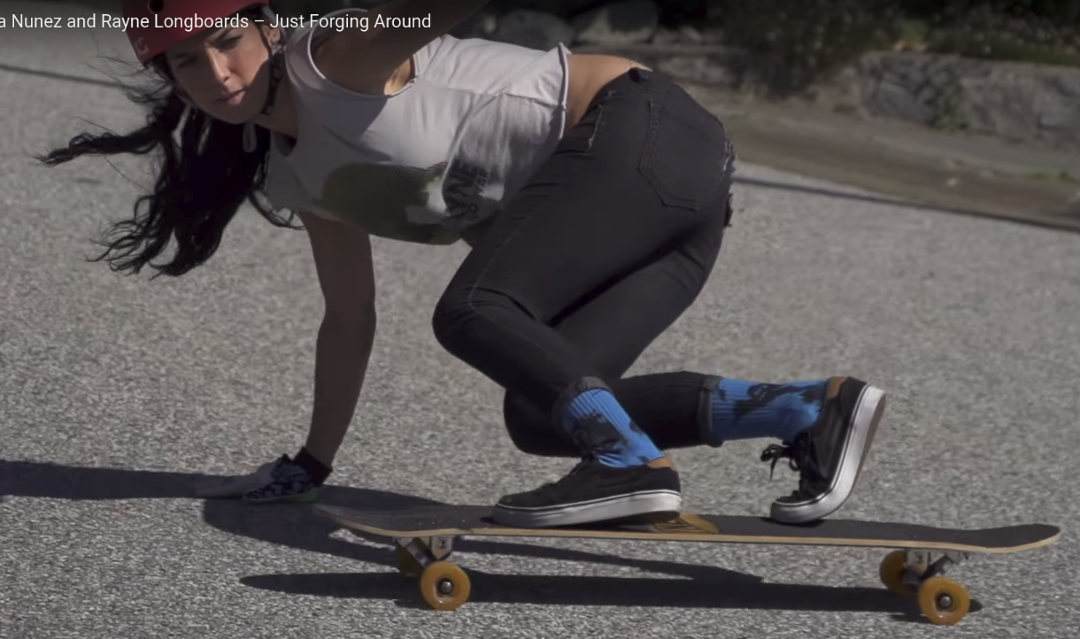
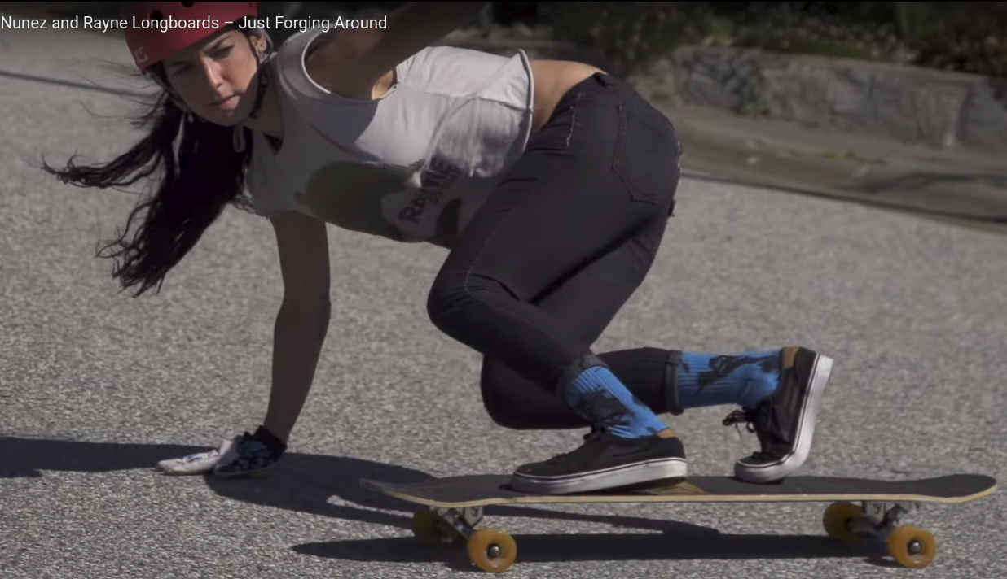
Most of body weight on the front foot. Rear foot just like a rudder only
Your eyes LOOK-ing (!!) at the direction (downhill) you’re going – important!

Slide 9
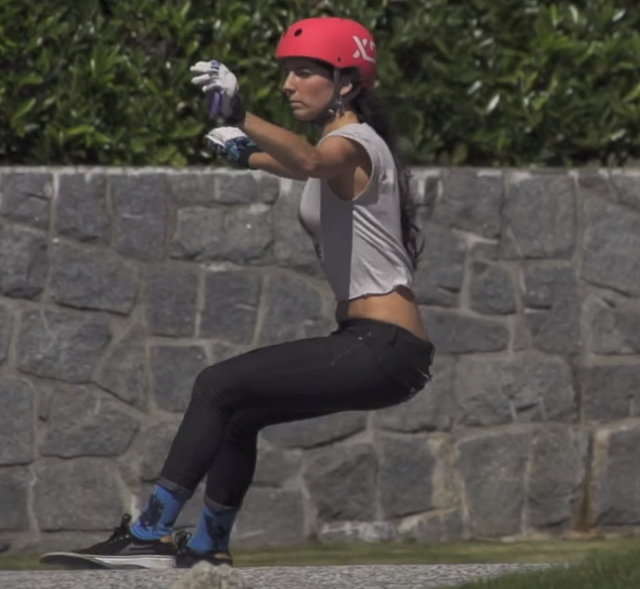
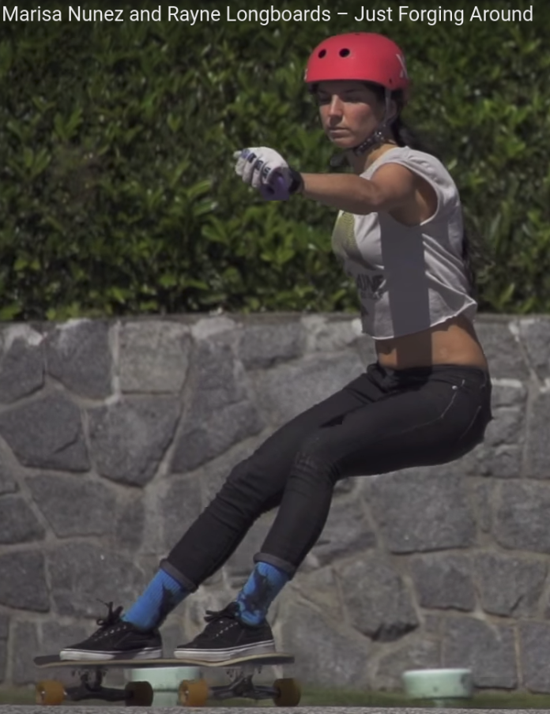
Your eyes LOOK-ing (!!) at the direction (downhill) you’re going – important!
Sitting on ‘virtual chair” position to create PUSH sliding
Both feet ‘in-parallel’ with the ground!!

Slide 10
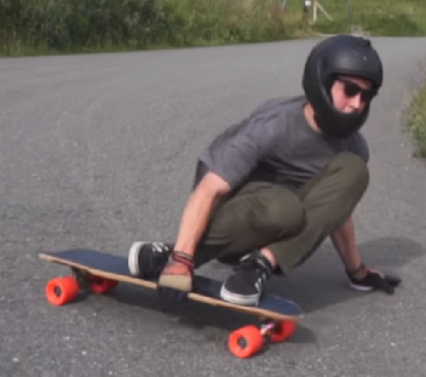
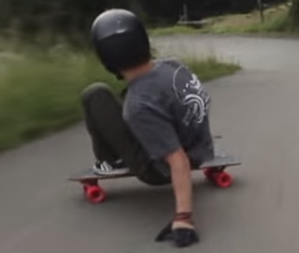
Josh Newman

Slide 11
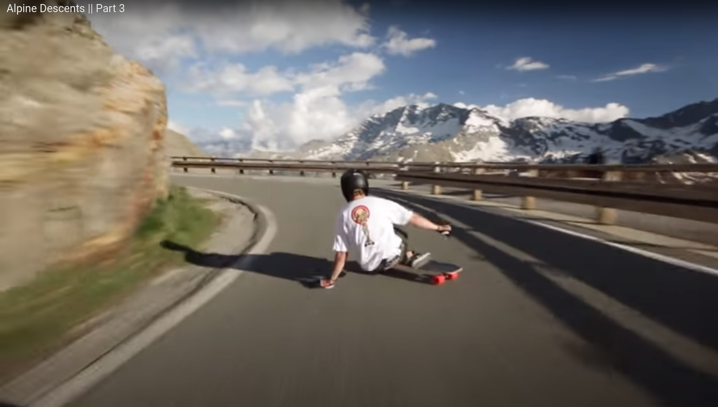
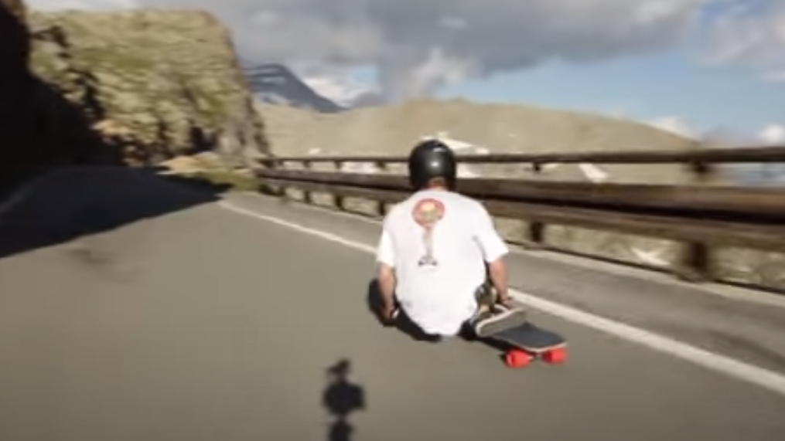

Slide 12
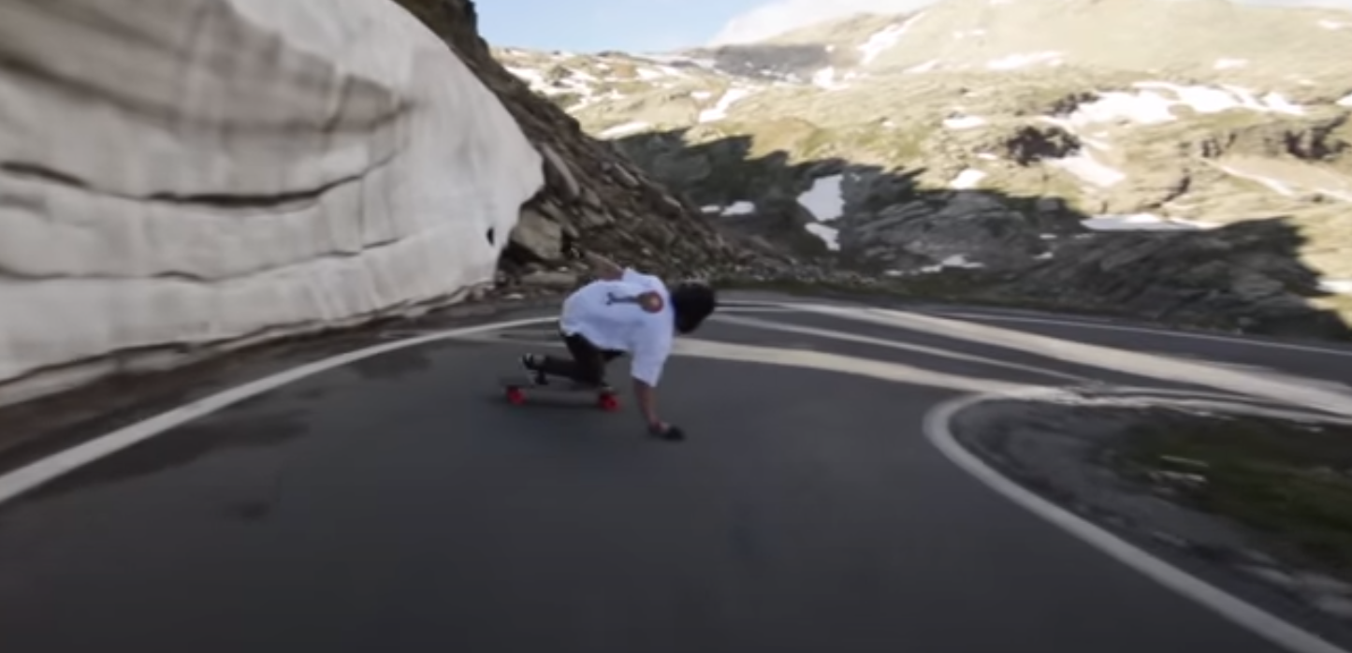
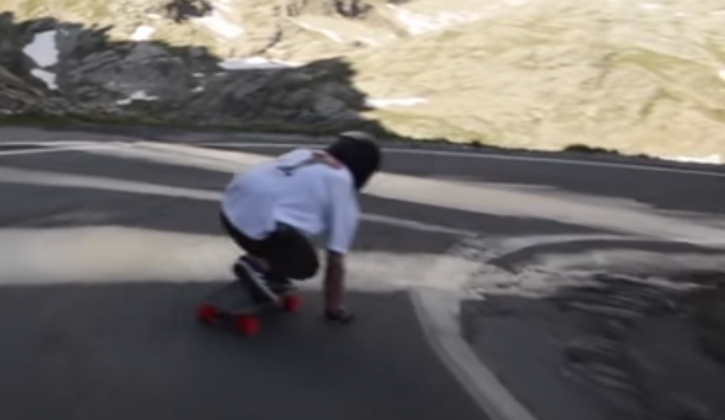

Slide 13

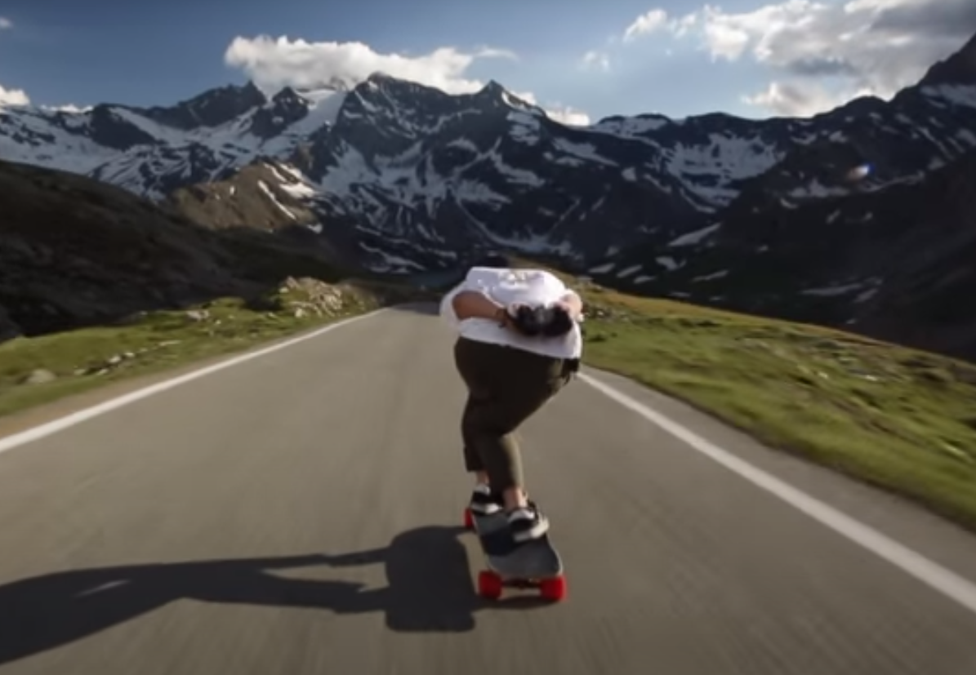
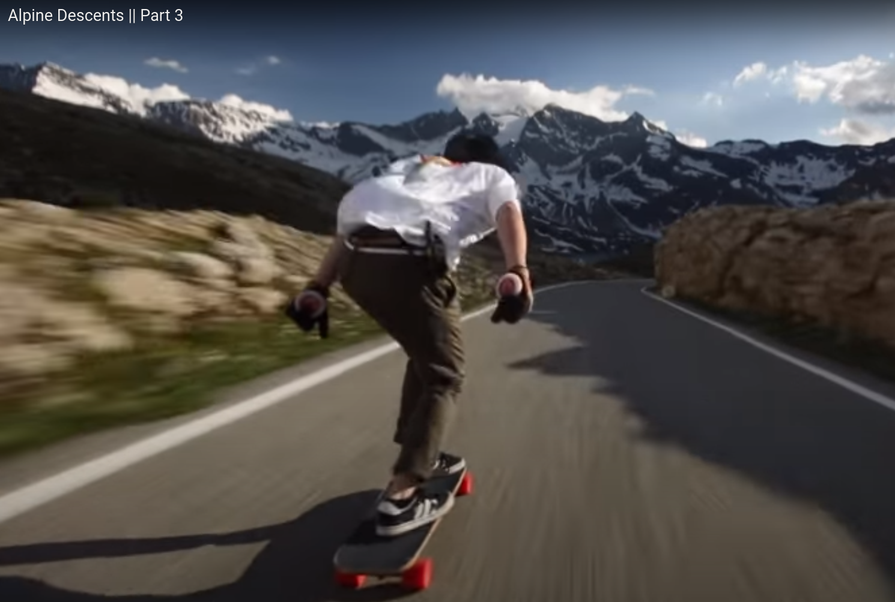

Slide 14
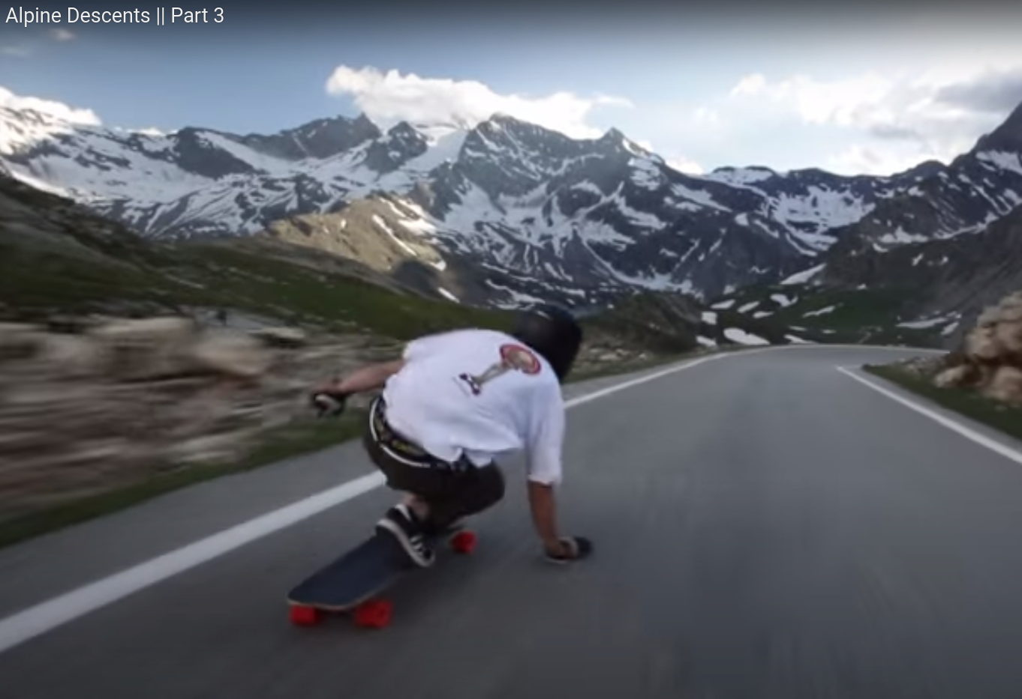
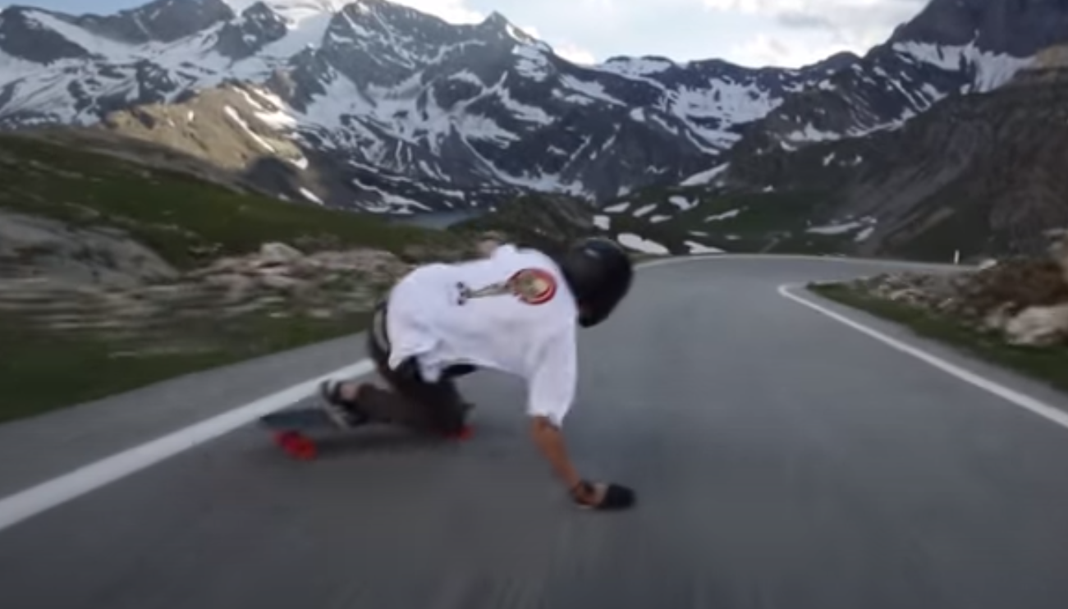
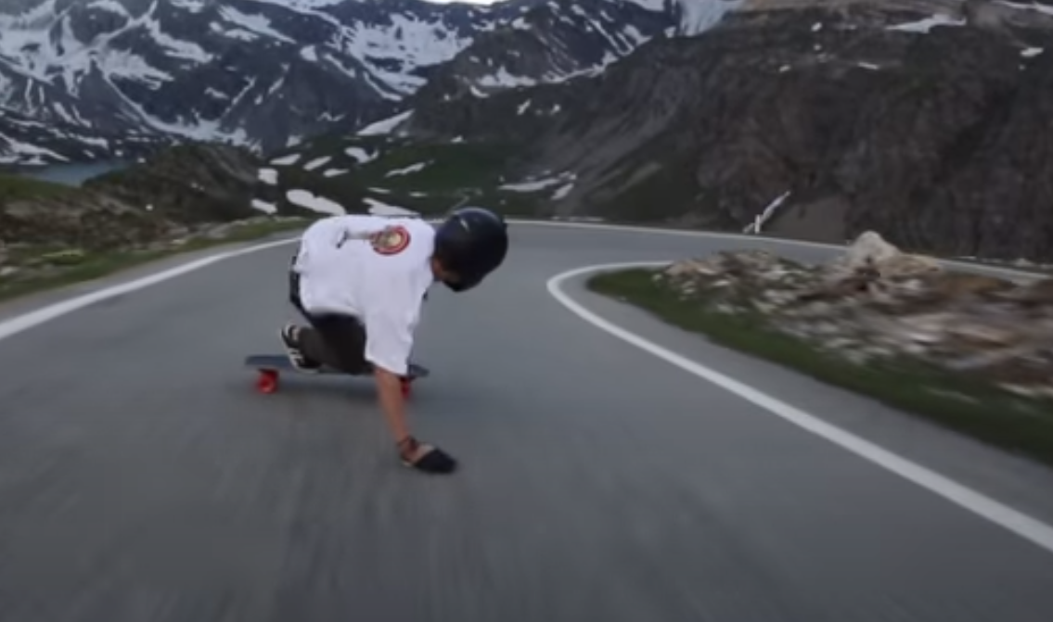
1. approaching corner
1. approaching corner – Palm down the side you want to turn.
Josh Neuman
2. rear foot ‘KICKing’ out a bit
3. Eyes LOOKing at the direction of traveling while dragging your sliding glove.

Slide 15
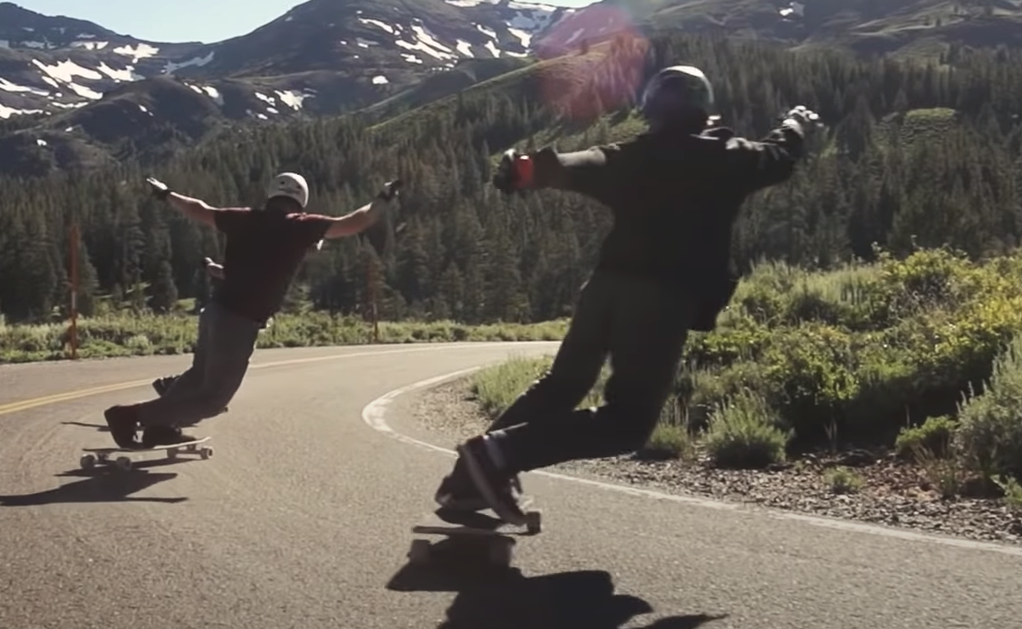

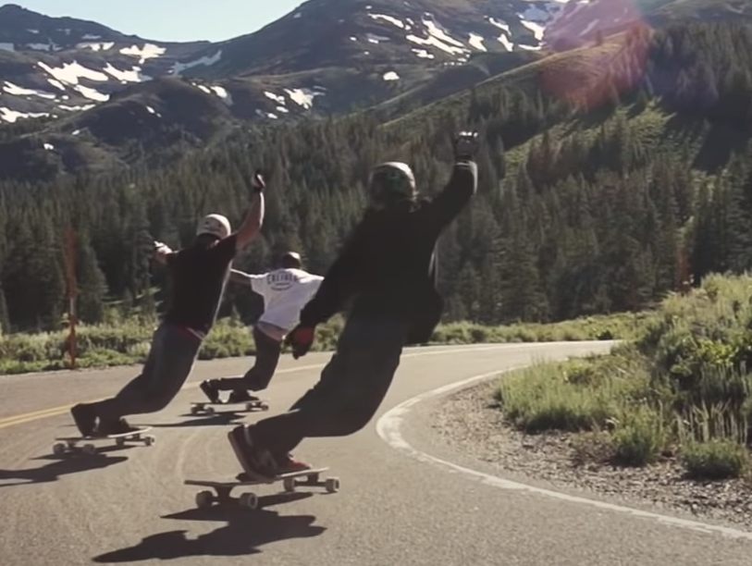

Slide 16
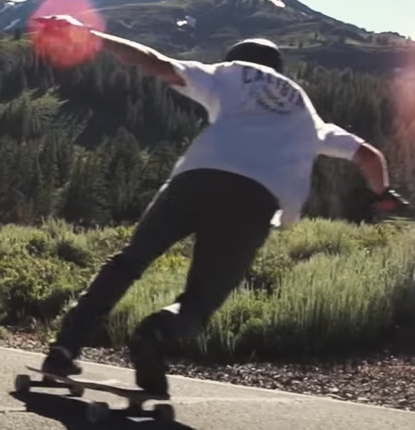
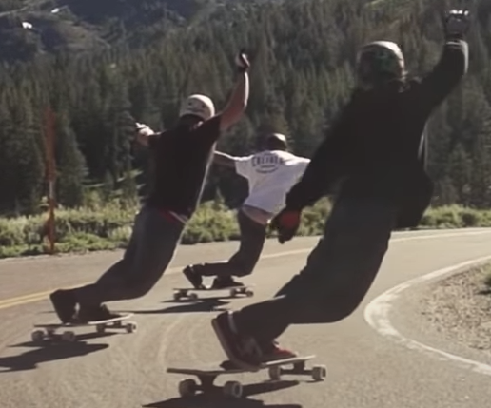

Slide 17
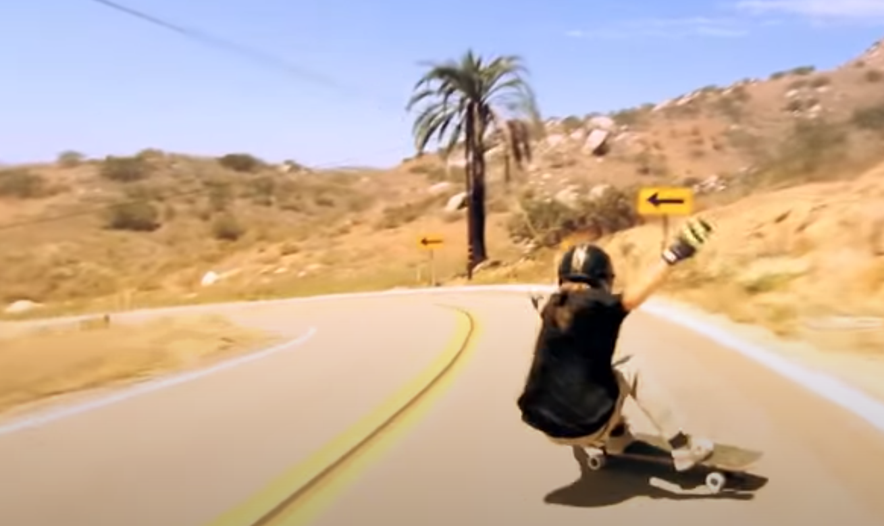
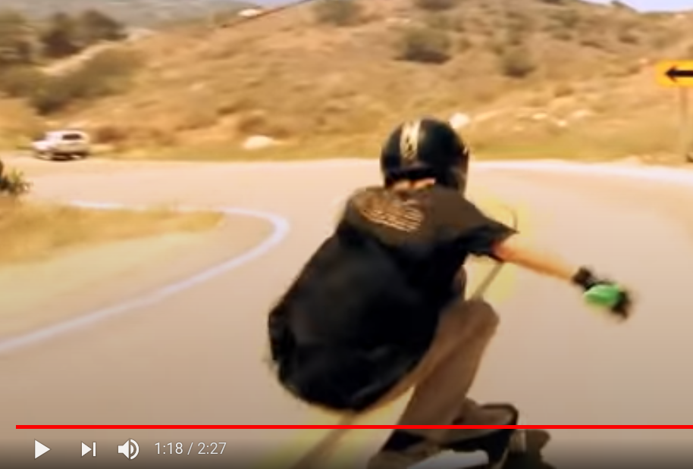
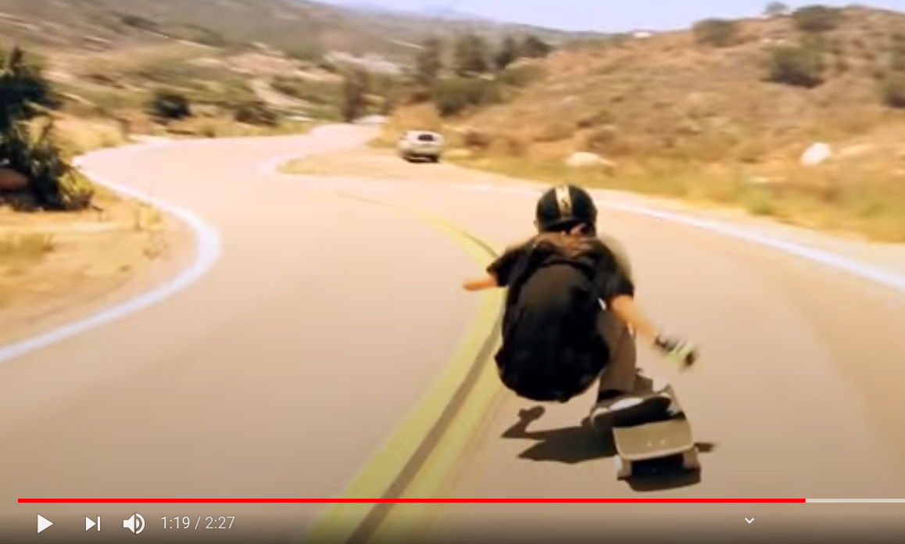

Slide 18
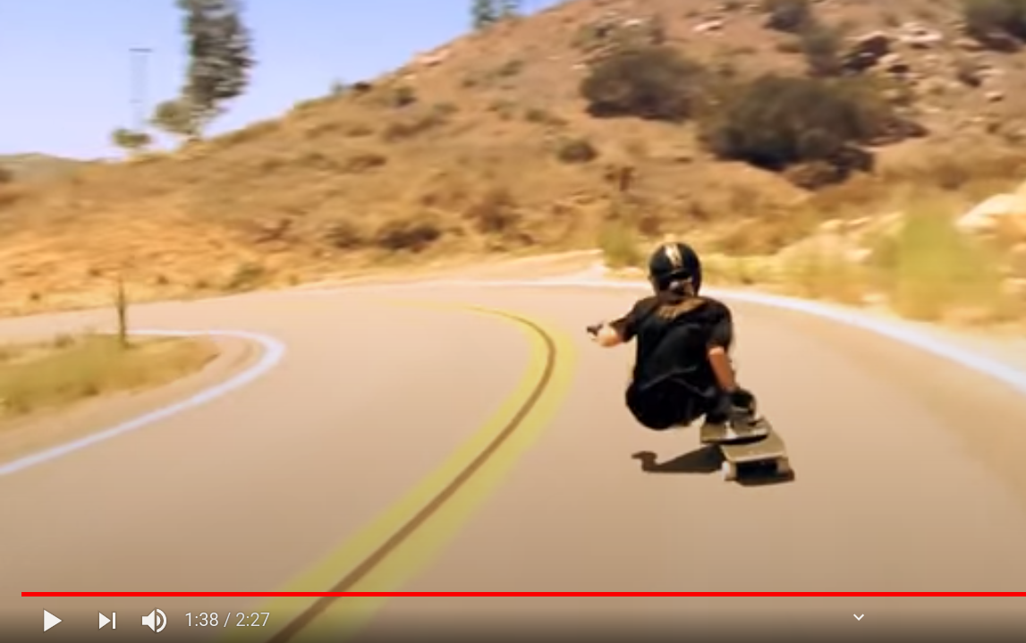
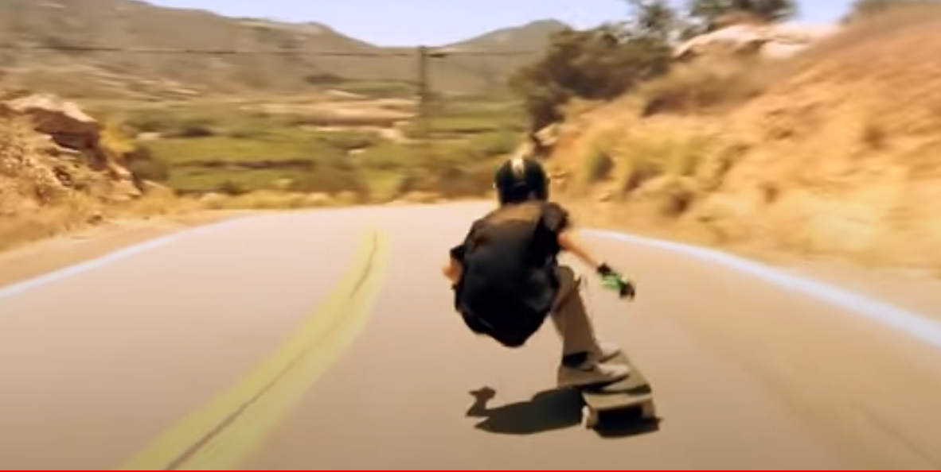
Jasper Ohlson
https://www.youtube.com/watch?v=R5-hWJZT0d0&feature=emb_logo

Slide 19
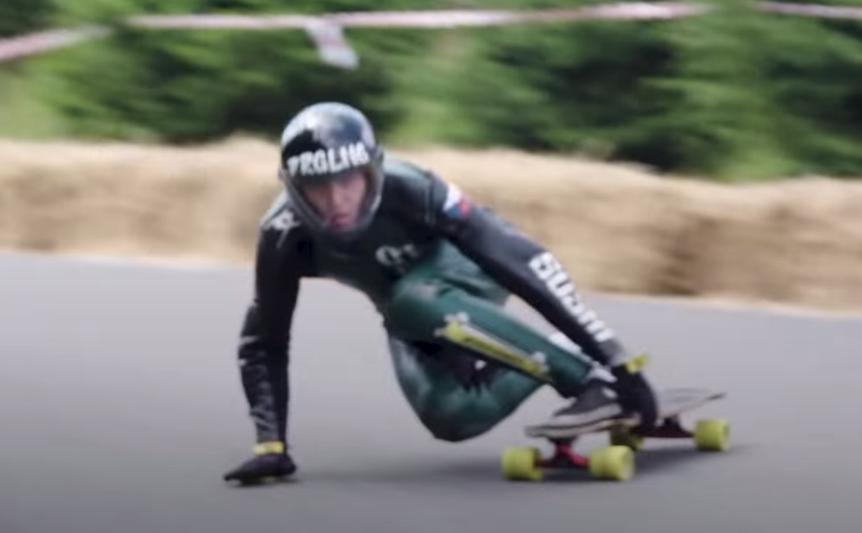
Racing Style fore-hand Palm-down

Slide 20
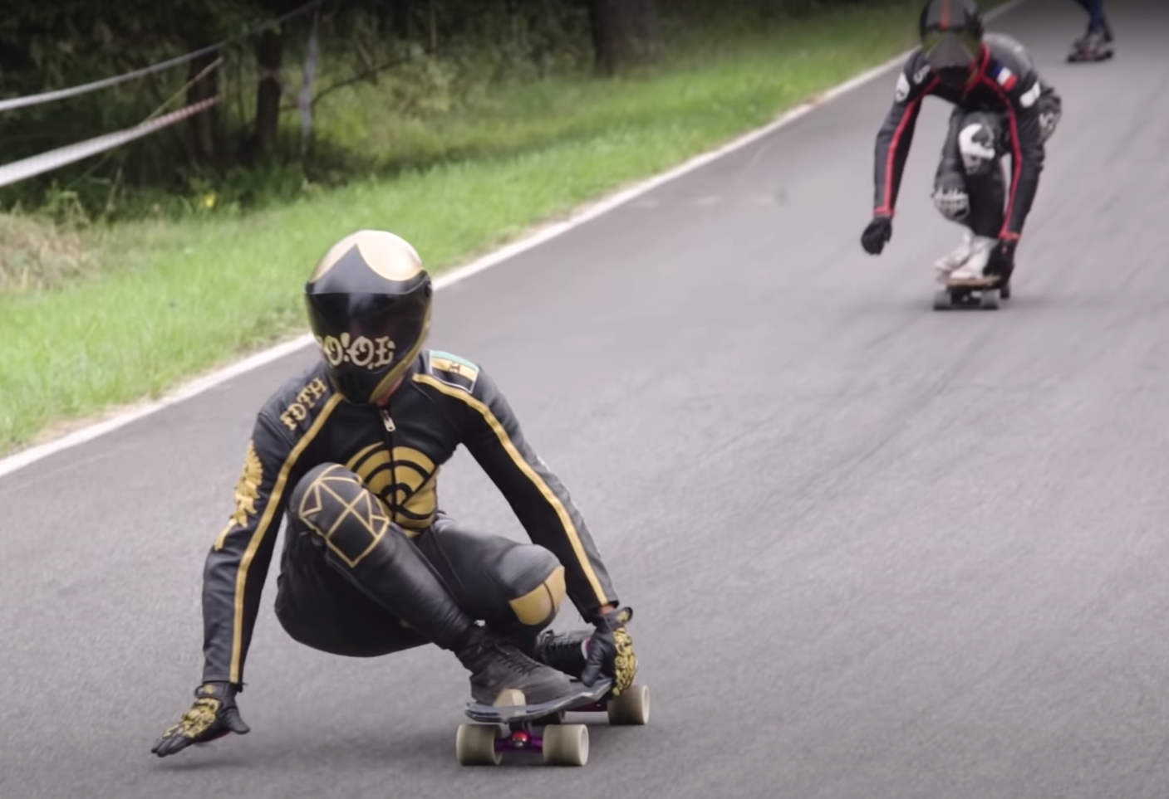
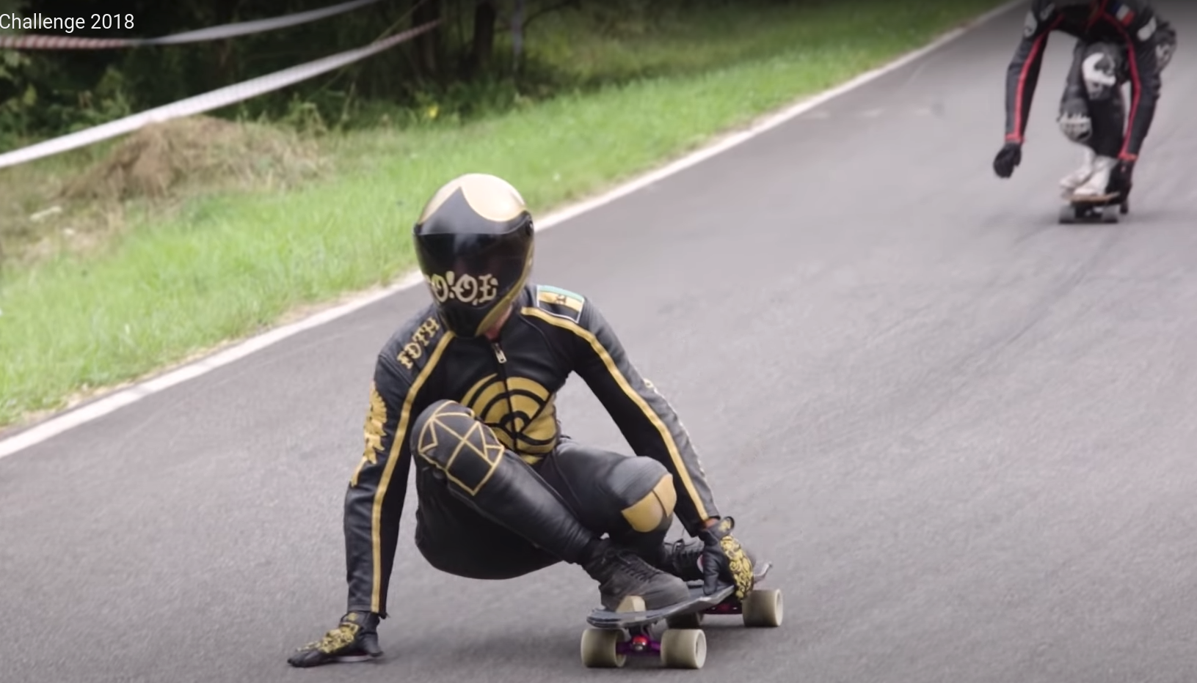
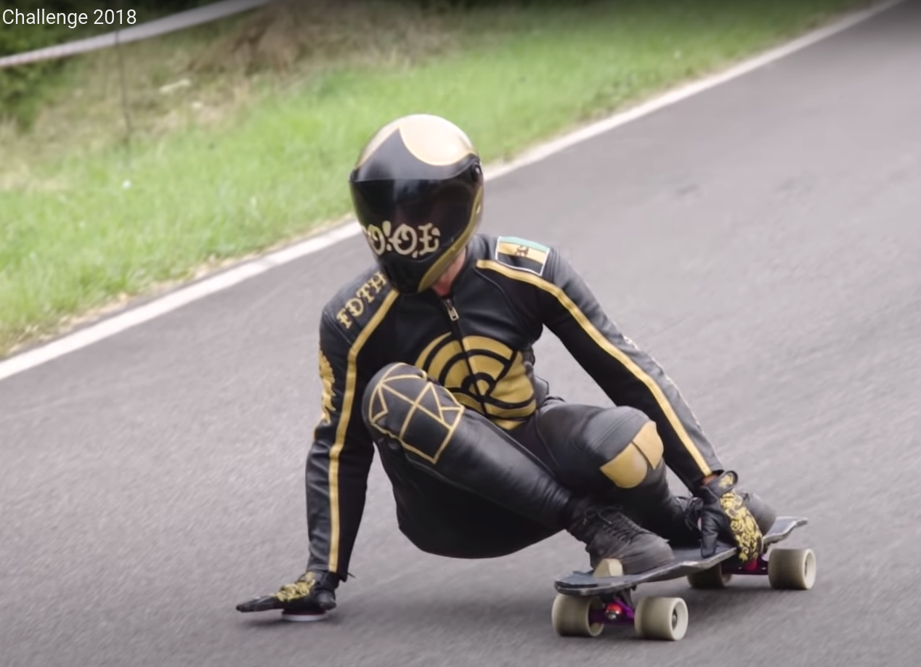
Racing Style Backhand Palm-down

Slide 21
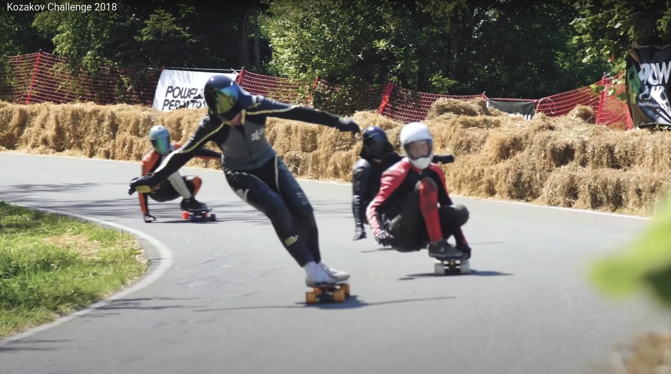
For Downhill Racing, Standing-turning style is mostly not common. Most downhill racers use squat-down to push center-of-gravity lowest to achieve maximum turning-stability.

